Slide 1
TIPS FOR PREPARING YOUR STUDENT FOR CAREER & COLLEGE SUCCESS
PRESENTED BY PHS COUNSELORS MRS. ROBIN SWEENEY & MRS. AMY HAGERMAN

Slide 2
HOW SOON SHOULD I START TALKING TO MY CHILD ABOUT THEIR FUTURE CAREER AND EDUCATION?
Elementary (Grades PK-4/5)
AWARENESS
Try to increase the types of careers and educational opportunities that are out there!
High School (Grades 9/10-12)
PLANNING
Continue exploring interests, and start narrowing the focus. Follow up with investigating & pursuing postsecondary options!
Middle School (Grades 5/6-8/9)
EXPLORATION
Let students take a variety of assessments to learn about who they are, what they enjoy/value & what they are good at
ANSWER: IT IS NEVER TO EARLY! YOU SIMPLY CANNOT WAIT UNTIL LATE IN HIGH SCHOOL TO START THINKING ABOUT YOUR FUTURE. IN TERMS OF CAREER DEVELOPMENT, THERE ARE REALLY 3 STAGES: AWARENESS, EXPLORATION, & PLANNING.

Slide 3
WHAT KIND OF CAREER ASSESSMENTS ARE OUT THERE & WHERE CAN I FIND THEM?
LEARNING STYLES
INTERESTS
SKILLS & ABILITIES
VALUES
Learning Styles Inventory in Career Cruising, Kolb’s Learning Style Inventory, Fleming’s VARK Learning Style Questionnaire
O*NET Work Importance Locator, Life Values Self-Assessment Test, InSight Values/Work Characteristics Inventory, 123test Work Values Test
PERSONALITY
Big 5 Personality Traits, Holland Codes Personality Test, Meyers-Briggs Type Indicator, True Color Personality Test
Career Matchmaker in Career Cruising, Roadtrip Nation’s The Roadmap, TX GEAR UP’s Discover You Quiz, TEXASgenuine Assessment
Ability Profiler in Career Cruising, CareerOneStopSkills Profiler, Thrively, 3 Smart Cubes, Sokanu
ANSWER: IN CAREER DEVELOPMENT, IT IS IMPORTANT TO ASSESS ONESELF IN MULTIPLE WAYS TO GET A GOOD OVERALL PICTURE OF WHAT TYPES OF CAREERS MIGHT BE A GOOD FIT. IN GENERAL, THERE ARE 5 CATEGORIES OF ASSESSMENTS:
LEARNING STYLES INVENTORIES: Teaches a student what type of learner they are
INTEREST INVENTORIES: Allows a student to identify what they are most interested in & careers that align with those interests
SKILLS/ABILITIES INVENTORIES: Allows a student to identify what they are good at & careers that require those talents.
VALUES INVENTORIES: Allows students to identify what is most important to them in regard to motivation, working conditions and much more
PERSONALITY ASSESSMENTS: Helps students find careers suited to their characteristics, strengths & weaknesses

Slide 4
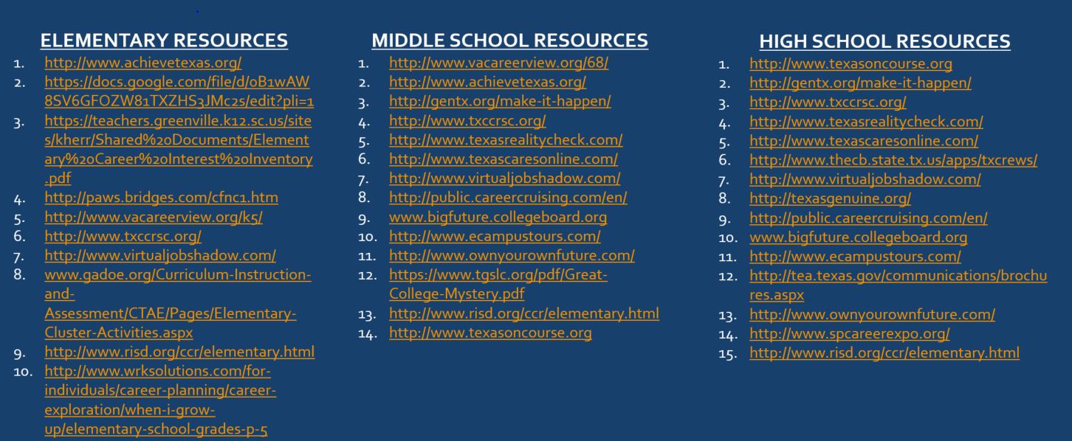
WHAT ARE SOME FINAL THOUGHTS & RESOURCES FOR COLLEGE/CAREER DEVELOPMENT FOR MY STUDENT?
FINAL THOUGHTS:
Don’t rely to heavily on a single assessment when exploring – interests, values, etc. can change and the results are not meant to be definitive. These assessments are just a bridge to discovering what is out there!
Take advantage of free resources! All PISD students grade 7 & up have access to Career Cruising, as do their parents & Texas OnCourse is a great site with free college/career planning resources!

